Slide 1
Quick Recap

Slide 2
index.html
<!doctype html>
<html>
<head>
<title>
Домашняя страница Васи Пупкина
</title>
</head>
<body>
...
</body>
</html>
web page

Slide 3
<tag> </tag>
теги

Slide 4
nested.html
<div>
<div> Какой-то блок </div>
<div>
Нырнём поглубже
<div> Достаточно. </div>
</div>
</div>
<div>
<div>
<div>
<div>
DOM Tree
вложенные теги

Slide 5
<tag attr='value'>
атрибуты

Slide 6
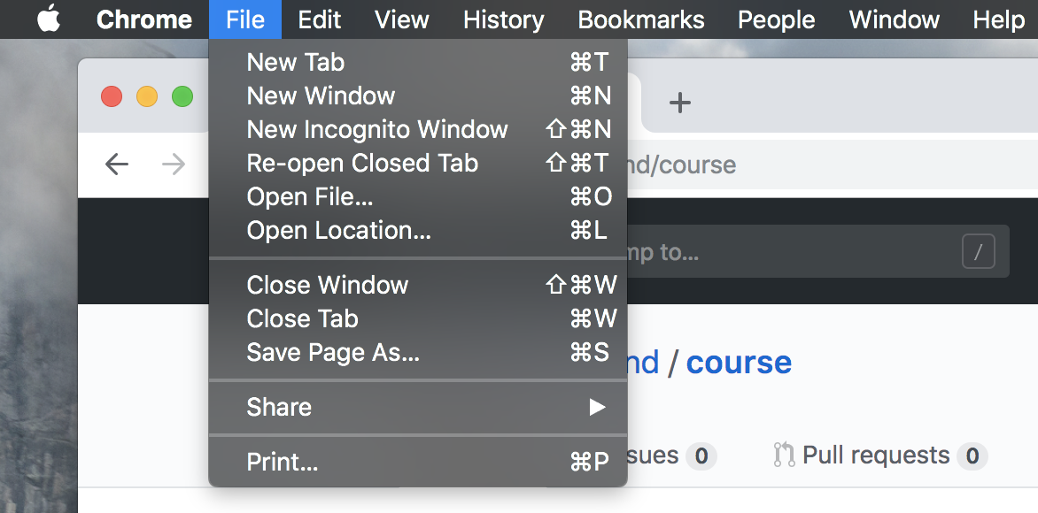
glance at your creation

Slide 7
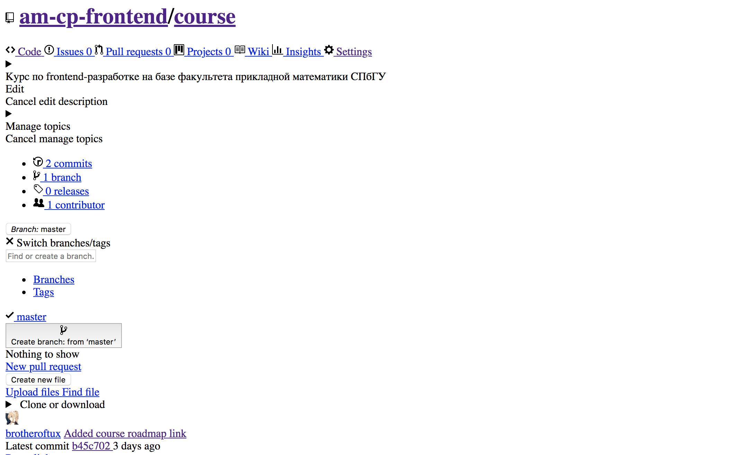
why

Slide 8
selector {
property: value;
}
basic syntax

Slide 9
.className
#idValue
div
селекторы

Slide 10
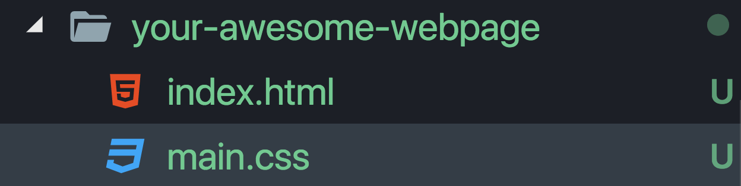
file tree

Slide 11
<link rel='stylesheet'
href='main.css' />
тег link

Slide 12
Практика

Slide 13
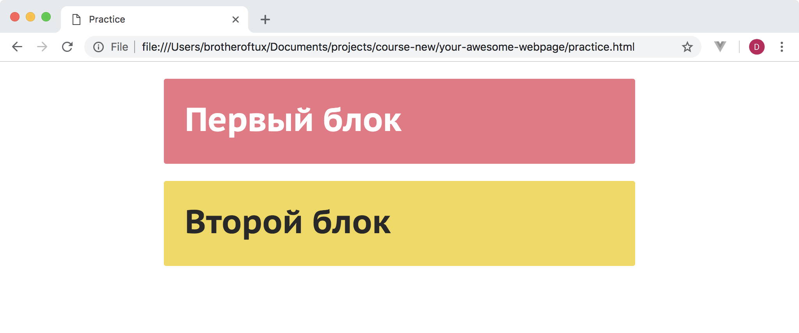
practice

Slide 14
JS

Slide 15
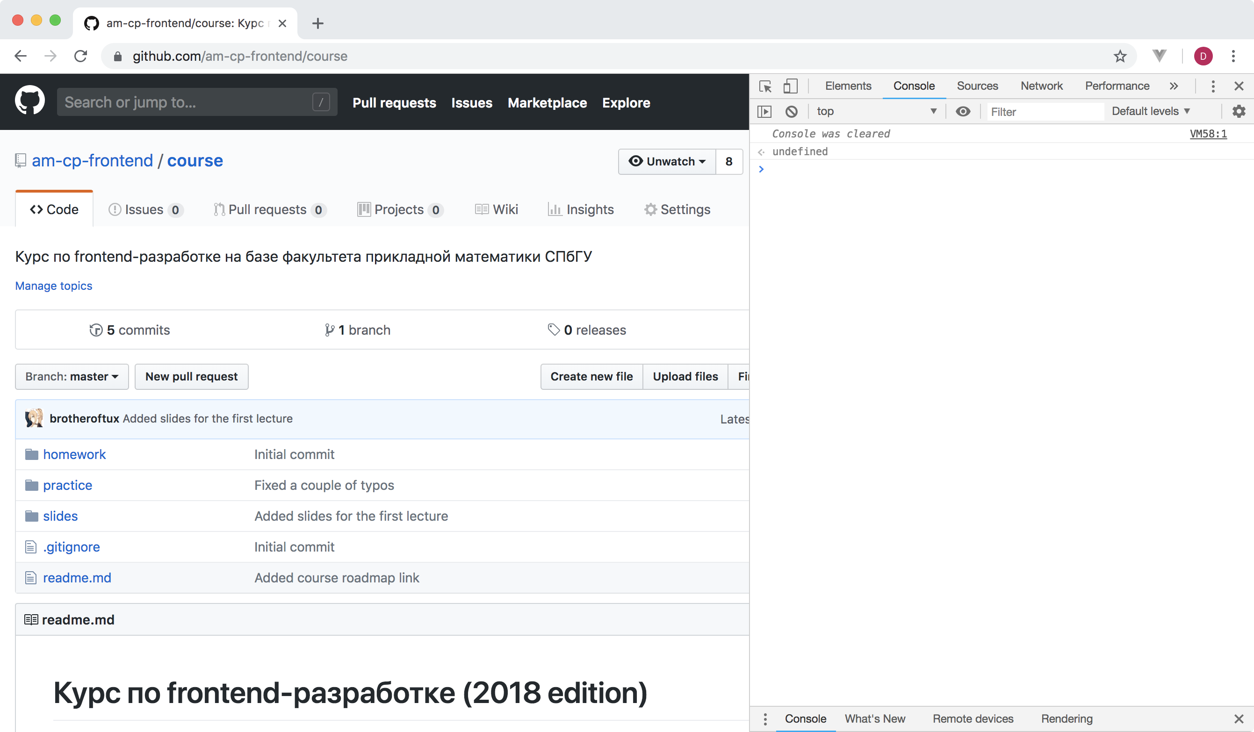
devtools encounter

Slide 16
Basics

Slide 17
let variable = value
variables

Slide 18
To ; or not to ;

Slide 19
var variable = value
bad

Slide 20
const some = constVal
pro

Slide 21
variables.js
const number = 0.5
const string = ‘Hey guys, massive legend here!’
const array = [‘some’, 42, number]
// yikes
const greeter = name => `Hello, ${name}`
console.log(greeter(‘world’))
examples

Slide 22
Типы данных

Slide 23
Number

Slide 24
42.0
Number

Slide 25
> 42 / 0
Infinity
Number

Slide 26
String

Slide 27
‘Продам гараж’
String

Slide 28
> ‘THANOS’ + ‘CAR’
THANOS CAR
String

Slide 30
const str = ‘Hello’
str[0] = ‘B’
// no effect
immutable

Slide 31
Boolean

Slide 32
> true !== false
true
Boolean

Slide 33
Null

Slide 34
Undefined

Slide 35
Symbol

Slide 36
Object

Slide 37
const object = {
someKey: ‘value’,
another: 7
}
Object

Slide 38
> object.someKey
value
> object[‘another’]
7
Object

Slide 39
const a = {k: 1}
const b = a
a.k = 2
b.k
// 2
always by reference

Slide 40
Синтаксические конструкции

Slide 41
If clause

Slide 42
if (condition) {
statements
}
if

Slide 43
if (condition) {
statements
} else {
more statements
}
if-else

Slide 44
if (condition) {
statements
} else if (cond) {
more statements
}
if-elseif

Slide 45
0, null, undefined, ‘’,
false, NaN
falsy

Slide 46
if (‘0’)
console.log(‘yikes’)
truthy

Slide 47
> 5 == ‘5’
true
> 5 === ‘5’
false
many pitfalls of js comparisons

Slide 48
Lööps

Slide 49
while (condition) {
statements
}
while

Slide 50
for (i; cond; i++) {
statements
}
for

Slide 51
for (el of iterable) {
statements
}
for-of

Slide 52
for-of.js
const numbers = [1, 2, 3, 7]
for (let number of numbers)
console.log(number)
/*
1
2
3
7
*/
for-of

Slide 53
for (key in iterable) {
statements
}
for-in

Slide 54
for-of.js
const numbers = [1, 2, 3, 7]
for (let index in numbers)
console.log(index)
/*
0
1
2
3
*/
for-in

Slide 55
Functions

Slide 56
function name (args) {
statements
}
functions

Slide 57
function (args) {
statements
}
anonymous functions

Slide 58
anonymous.js
const greeter = function (name) {
console.log(‘Hello, ‘ + name.toString())
}
greeter(‘Billy’)

Slide 59
Практика

Slide 60
DOM API

Slide 61
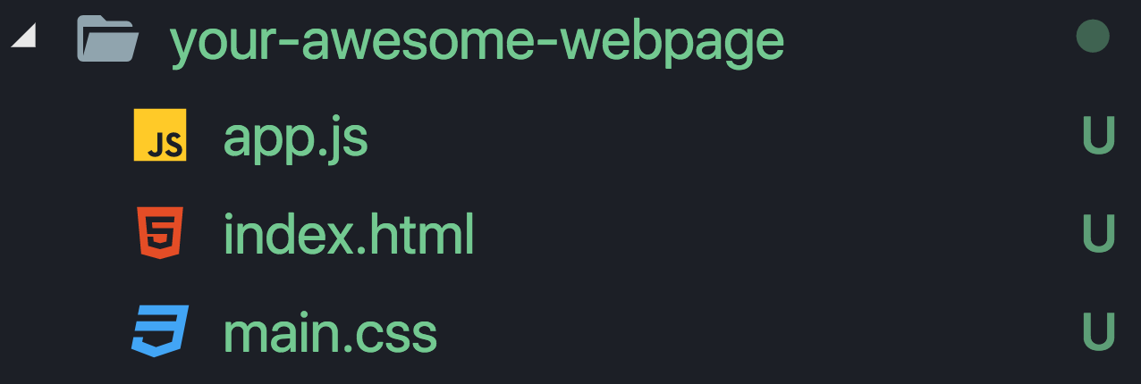
file tree

Slide 62
<script src=‘app.js’>
</script>
include

Slide 63
<script>
your awesome code
</script>
or

Slide 64
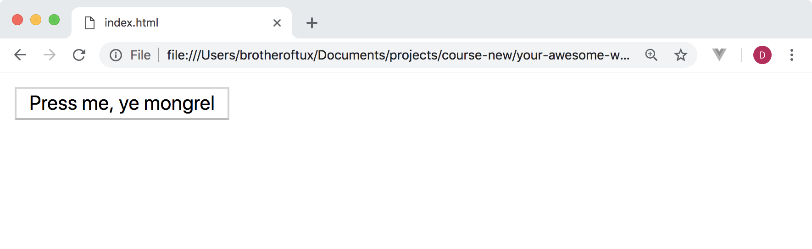
button.html
<button id=‘button’>Press me, ye mongrel</button>
button tag

Slide 65
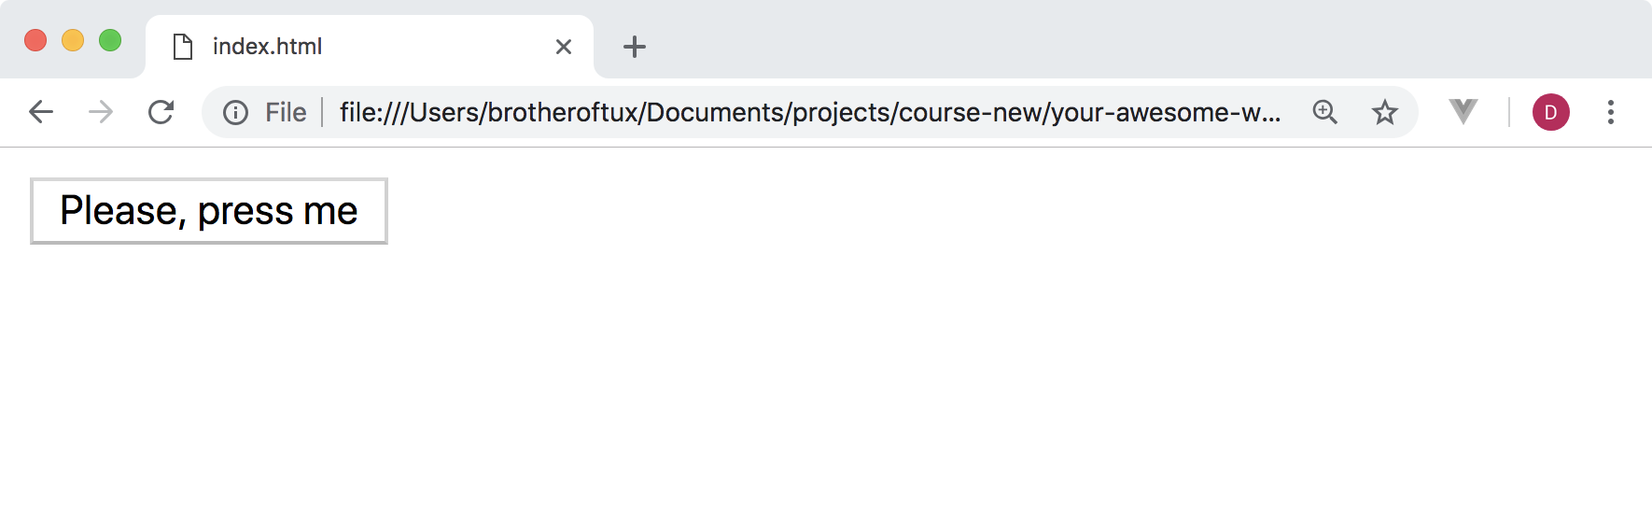
queryselector.js
const button = document.querySelector(‘#button’)
button.textContent = 'Please, press me'
query selector

Slide 66
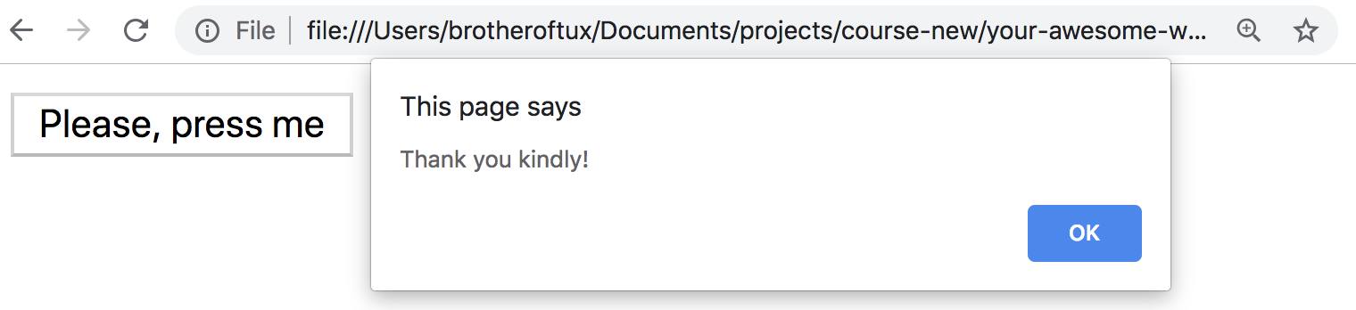
addEventListener.js
const button = document.querySelector(‘#button’)
button.addEventListener(‘click’, function () {
alert(‘Thank you kindly!’)
})
event listeners

Slide 67
Практика

Slide 68
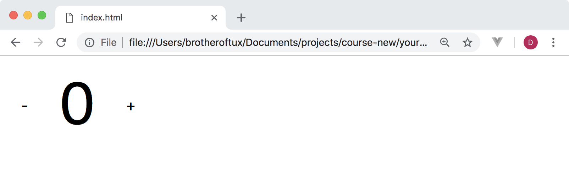
practice

